Slide 1
CHAPTER 6:
CONTROL AND IMPLEMENTATION OF STATE SPACE SEARCH

Slide 2
Members
Nguyen Hoang Lam - ITITIU16038
Tran Le Minh Trung - ITITIU16138
Pham Giao Huy - ITITIU16031
Ho Thanh Hoai - ITITIU16026

Slide 3
OUTLINE
I. Recursion-Based Search:
II. Production System:
III. The Blackboard Architecture for Problem Solving:

Slide 4
1/ Recursion Based-Search
A recursive procedure consists of:
  – A recursive step: the procedure calls itself to repeat a sequence of actions
  – A terminating condition that stops the procedure from recurring endlessly
Recursion is also a natural control construct for data structures that have regular structure and no definite size, such as lists, trees, graphs, and is particularly appropriate for state space search

Slide 5
Fibonacci Number Example
The Fibonacci numbers are the numbers in the following sequence:
0,1, 1, 2, 3, 5, 8, 13, 21, 34, 55, 89, 144, …
By definition, the first two numbers in the Fibonacci sequence are 0 and 1, and each subsequent number is the sum of the previous two.
The sequence F(n) of Fibonacci numbers is defined as:
  F(0) = 0 F(1) = 1 F(n) = F(n-1) + F(n-2)

Slide 6
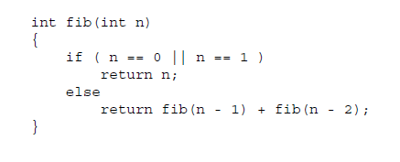

Slide 7
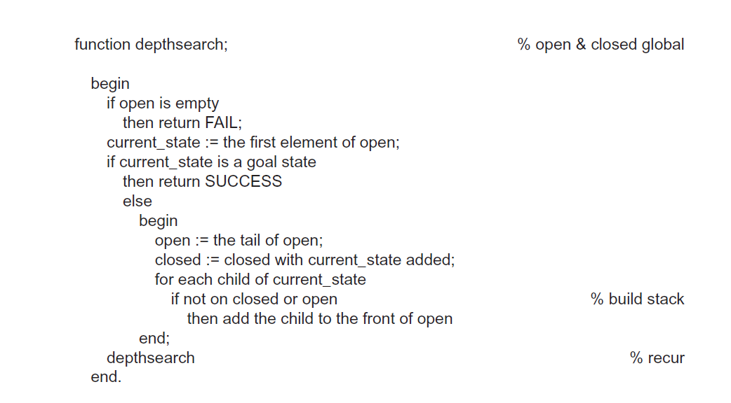
Depth-search
1/ Recursion Based-Search

Slide 8
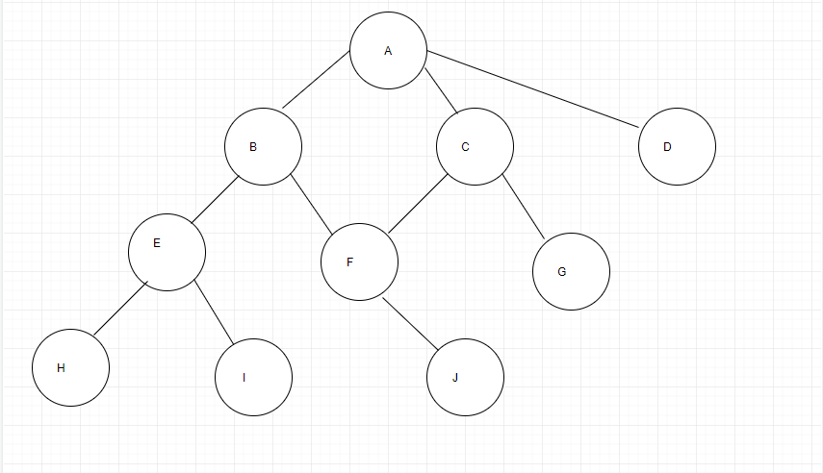
Iteration |  |  | Open | Close
0 |  |  | {A}
1 | A | {B,C,D} | {B,C,D} | {A}
2 | B | {E,F} | {C,D,E,F} | {A,B}
3 | C | {F,G} | {D,E,F,G} | {A,B,C}
4 | D |  | {E,F,G} | {A,B,C,D}
5 | E | {H,I} | {F,G,H,J} | {A,B,C,D,E}
6 | F | {J} | {G,H,I,J} | {A,B,C,D,E,F}
7 | G

Slide 9
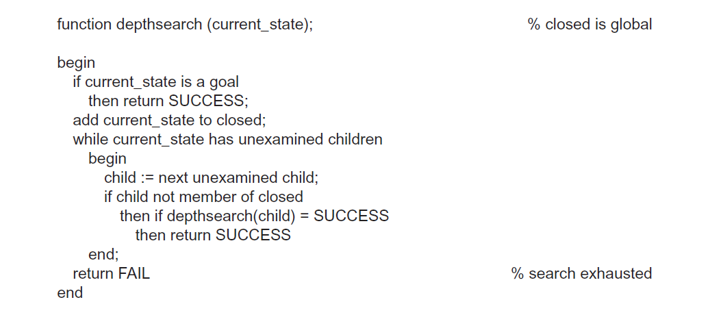
Simpler of Depthsearch

Slide 10
A Recursive Search Example: Pattern-Driven Reasoning
The algorithm determines if a predicate calculus expression is a logical result of some assertions.
It uses goal-directed search – given a goal (such as p(a))). the algorithm finds rules whose conclusions match the goal (q(X) -> p(X)) (assuming modus ponens defines the transitions between states)
After finding the rule and applying the substitutions throughout the rule, the rule premise becomes a new goal or subgoal
The algorithm then recurs on the subgoal

Slide 11
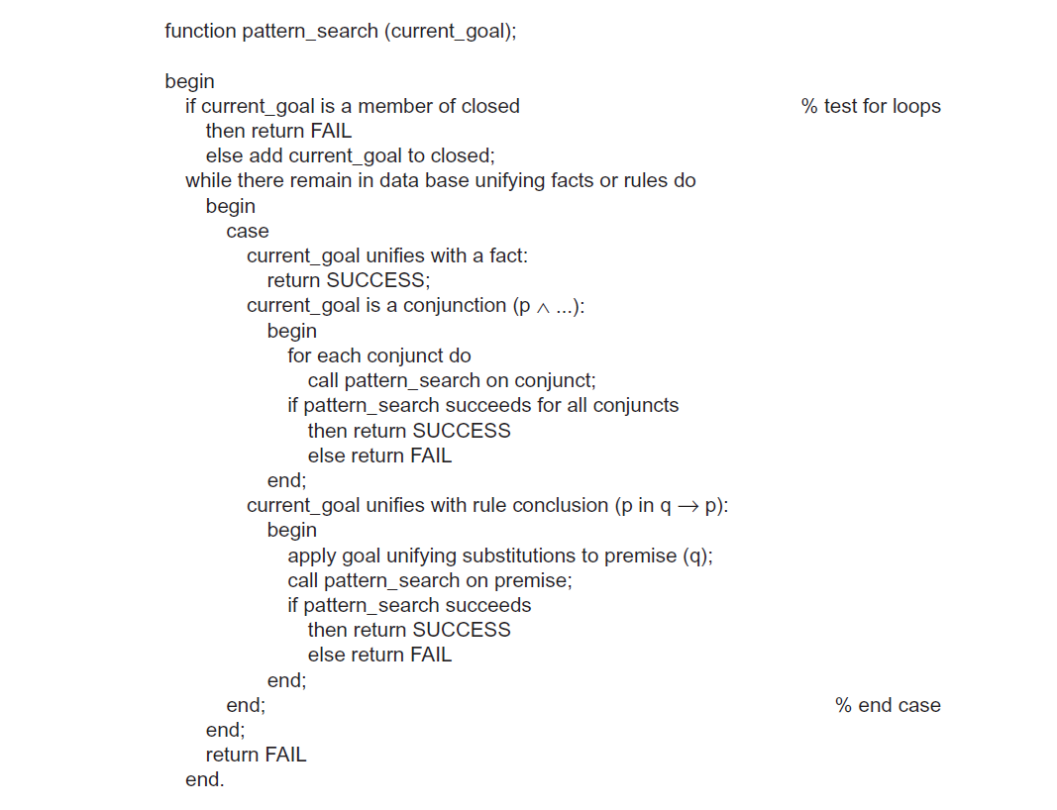
6.1.2 A Recursive Search Example: Pattern-Driven Reasoning

Slide 12
2/ Production Systems
Definition
  1. The set of production rules: a condition–action pair and defines single chunk of problem-solving knowledge, defines the associated problem-solving step(s).
  2. Describe of the current state in a reasoning process, match against the condition part to select appropriate problem-solving actions; actions are designed to alter the contents of working memory.
  3. Recognize–act cycle:
  Current state of the problem-solving is maintained as a set of patterns in working memory; the conditions of the production rules produces a subset of the production rules, called the conflict set if patterns are matched against these conditions.
  One of the productions in the conflict set is then selected (conflict resolution) and the production is fired.

Slide 13
Conflict resolution chooses a rule from the conflict set for firing; simple, such as selecting the first rule whose condition matches the stat, or may involve complex rule selection.
This is an important way in which a production system allows the addition of heuristic control to a search algorithm

Slide 14
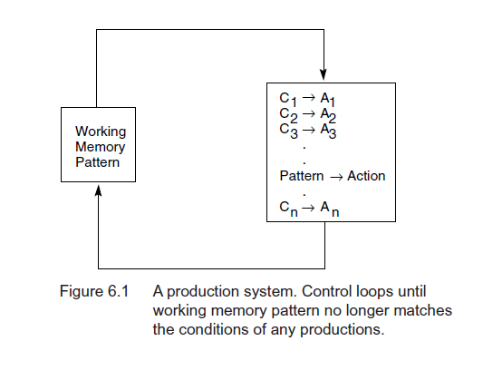

Slide 15
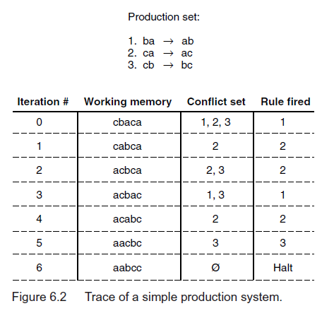

Slide 16
8-Puzzle Example
It is both complex enough to be interesting and small enough to be tractable
It has been used to explore various search strategies, such as depth-first and breath search, as well as heuristic strategies
We now present a production system solution to the 8-puzzle problem

Slide 17
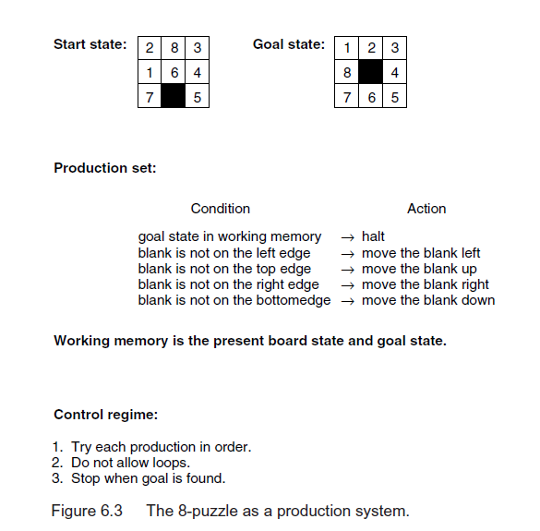

Slide 18
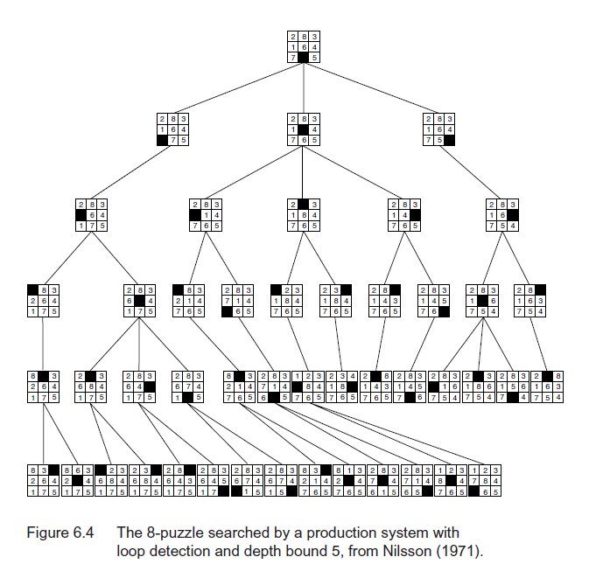

Slide 19
Knight’s Tour Example
A knight can move two squares followed by one square in an orthogonal direction
There are maximally eight possible moves a knight can make
The knight’s tour problem tries to find a series of moves such that the knight lands on each square exactly once
We solve the problem on a reduced-size (3x3)

Slide 20
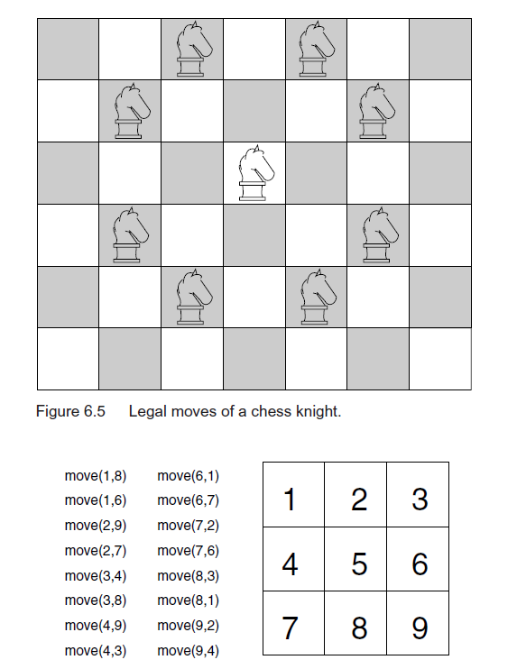
The knight’s tour problem:
- Square 5 is special square. The knight can’t reach it.

Slide 21
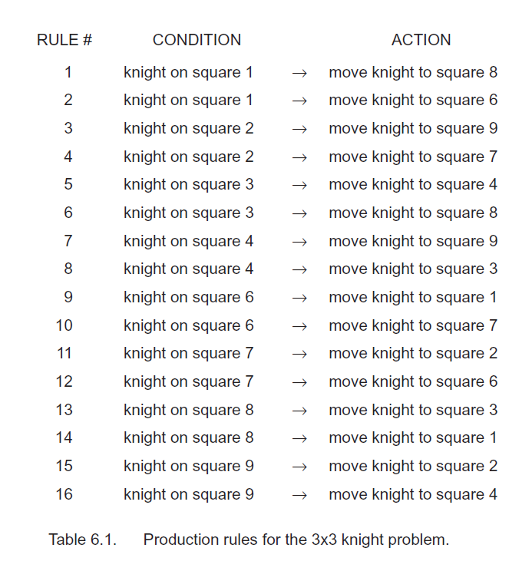
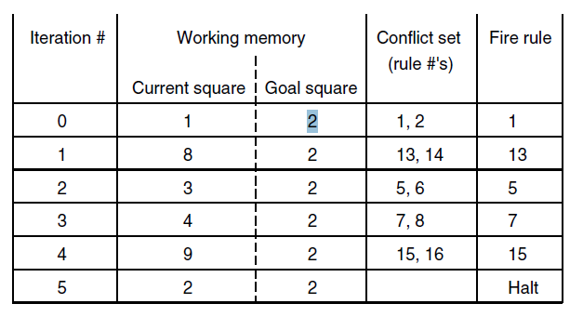
-Implement:

Slide 22

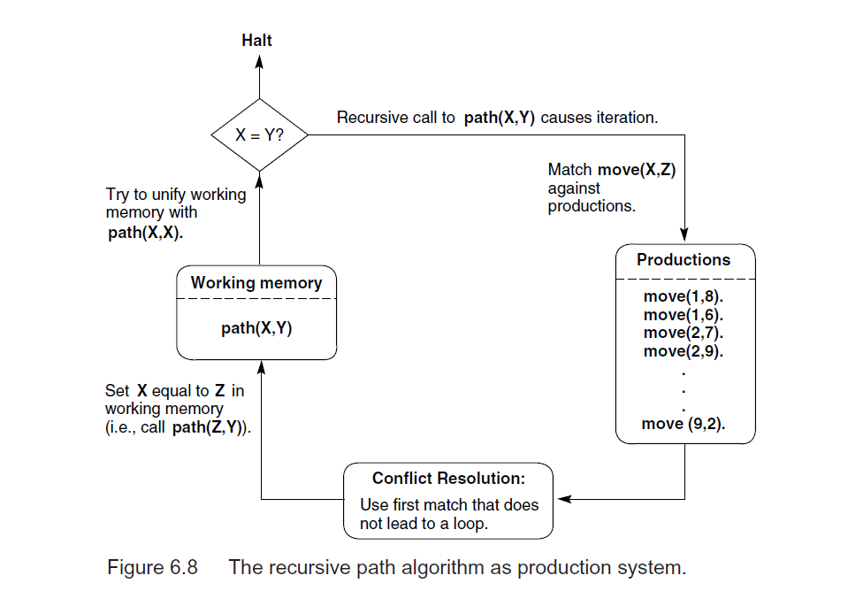
- Formula:
Diagram:

Slide 23
6.2.3 Control of Search in Production Systems
The production system model provides opportunities for adding heuristic control to the search algorithm, including:
  1) The choice of data driven or goal-drive search strategy
  2) The structure of the rules
  3) The different choice of conflict resolution

Slide 24
Data-Driven Search Strategy
Begins with a problem description, such as
  a set of logical axioms
  symptoms of an illness, etc …
Infers new knowledge from the data
  Applying rules of inference, legal moves in a game, or other state-generating operations to the current description of the world and adding the results to the problem description
This process continues until a goal state is reached

Slide 25
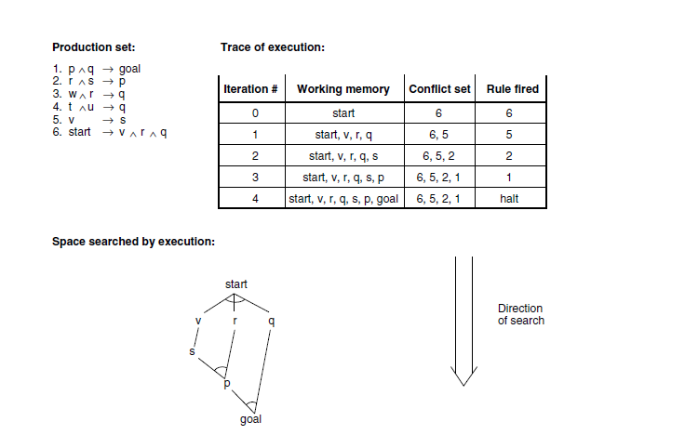

Slide 26
Goal-Driven Search Strategy
So far we have treated production system in a data-driven fashion
Goal-driven search begins with a goal and works backward to the facts of the problem
Initially the goal is placed in the working memory
When an ACTION of a rule is matched, the CONDITIONs are added to the working memory and become the new subgoals of the search
The process continues until facts that satisfy the goal are found

Slide 27
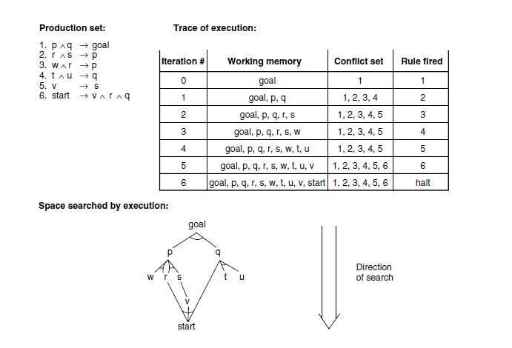
+ Goal-driven search in a production system:

Slide 28
Combination of Strategies
We can combine data-driven and goal-driven search strategies – search simultaneously from both directions
There is a danger that parts of the graph searched may “miss” each other, when heuristic or best-first search is used, resulting more search
If the bidirectional search meet in the middle, when the branching of a space is constant and exhaustive search is used, it can cut back drastically the amount of space searched

Slide 29
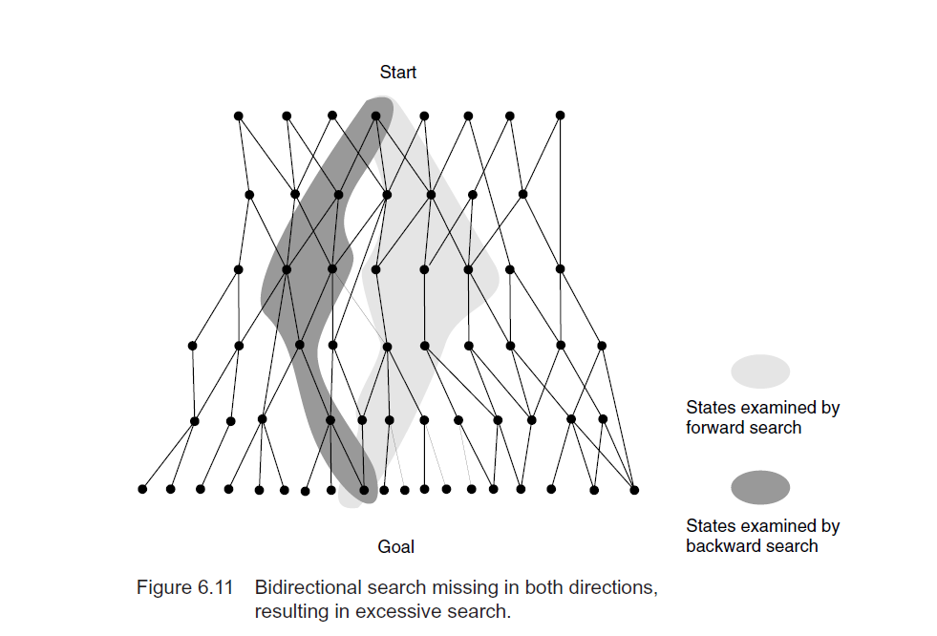

Slide 30
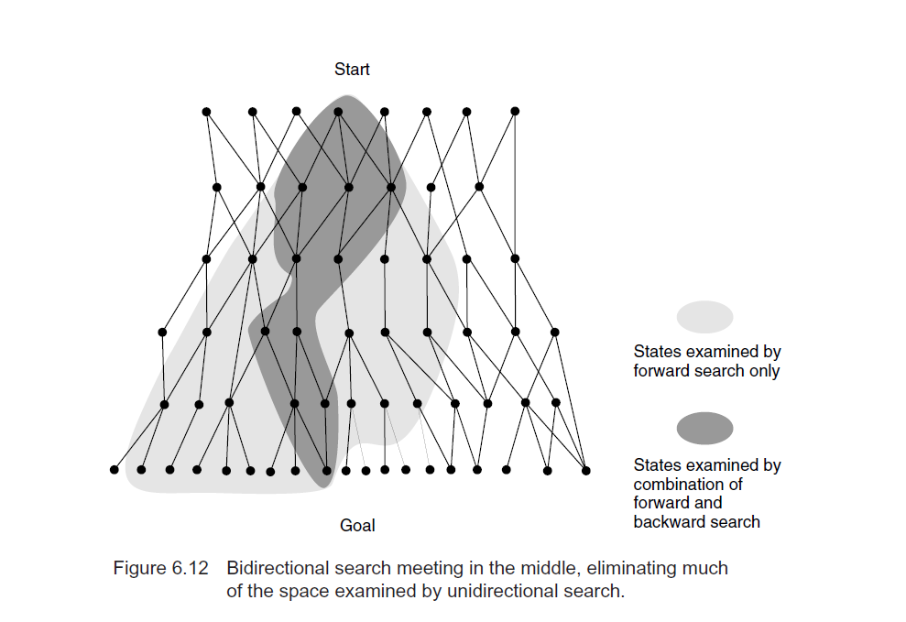

Slide 31
6.2.4 Advantages of Production Systems for AI
Separation of Knowledge and Control: The advantages of this separation include ease of modifying the knowledge base without requiring a change in the code for program control and, conversely, the ability to alter the code for program control without changing the set of production rules.
A Natural Mapping onto State Space Search: simplify the implementation, debugging, and documentation of search algorithms.

Slide 32
Modularity of Production Rules: This syntactic independence supports the incremental development of expert systems by successively adding, deleting, or changing the knowledge (rules) of the system.
Pattern-Directed Control: The descriptions of a problem that make up the current state of the world determine the conflict set and, consequently, the particular search path and solution.
Opportunities for Heuristic Control of Search.

Slide 33
Tracing and Explanation: The modularity of rules and the iterative nature of their execution make it easier to trace execution of a production system.
Language Independence: Regardless of the type of inference rules employed, however, the production system provides a vehicle for searching the state space.
A Plausible Model of Human Problem Solving.

Slide 34
6.3 The Blackboard Architecture for Problem Solving
Extend production systems.
Integrate separate sets of rules and coordinate the actions of multiple agents (each module is an agent – knowledge source).
A single global structure – blackboard.
=> Blackboard architecture – model of control requires coordination of multiple processes or knowledge sources(KS).

Slide 35
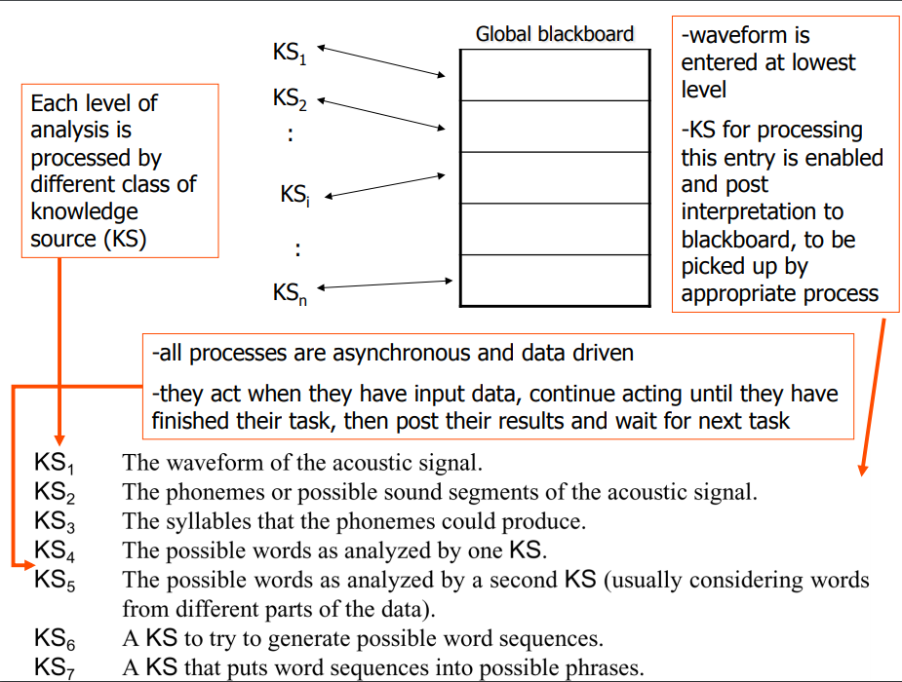

Slide 36
References
Luger2009-Artificial Intelligence. Structures and Strategies for Complex Problem Solving. Sixth Edition-Addison Wesley (2009)

Slide 37
Thanks For Listening
Any Question?

